Slide 1
Pixel detector MX-10
Author: Jakub Indrei
Supervisors: Vladimír Vícha, Kiril Gikal
University Center of JINR

Slide 2
Aim of the project
Aim of this project was to learn to work with a modern type of detector of ionizing radiation, namely MX-10 pixel detector.
Next aim was to meassure emitters with different types of ionizing radiation without any shielding and with different types of shielding, mainly aluminium.
Last aim was to take an air sample in room and to meassure the radioactivity of radon decay elements.

Slide 3
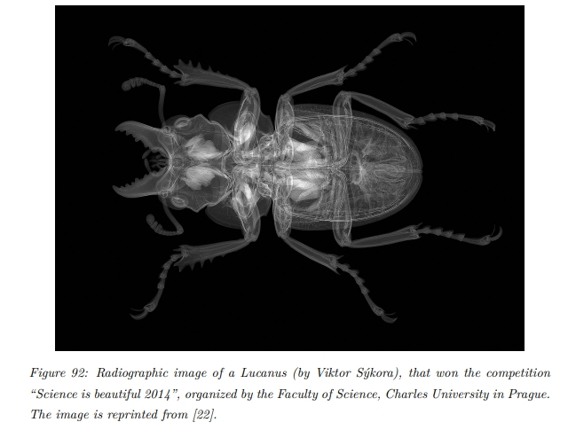
Aplications of pixel detectors

Slide 4
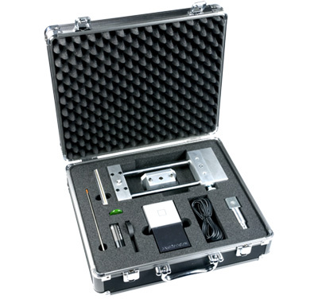
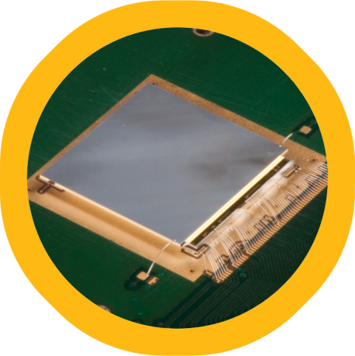
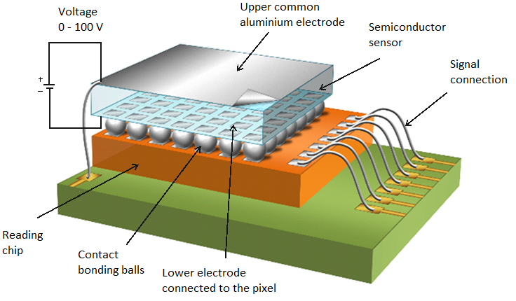
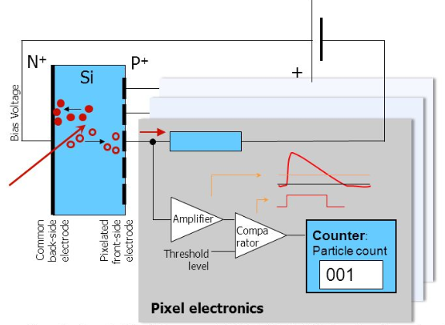
MX-10 description
MX-10, pixel detector
Silicon chip
Silicon chip
Area: 14x14 mm, 256x256 = 65 536 pixels
Area each pixel: 55x55 μm
Thickness: 300 μm
Function
Visualisation of traces of ionizing radiation,
particle resolution, particle counting,
energy meassurement
Set of Jablotron MX-10 Edukit
Principe of detection and processing signal
Scheme of detector layout

Slide 5
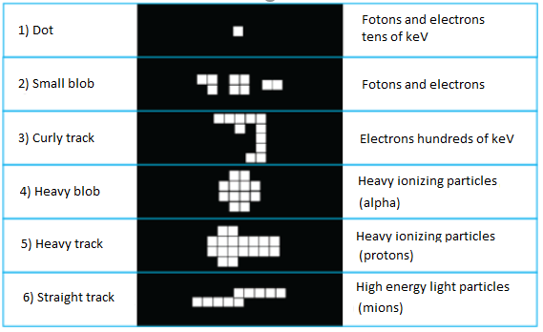
Pixelman
Examples of resolution of detected particles
Pixelman´s window from meassurement in flight
Heavy blob: E = 6 473 keV, 36 pixels
Heavy track: E = 1929 keV, 42 pixels
Straght track: E = 2688 keV, 136 pixels

Slide 6
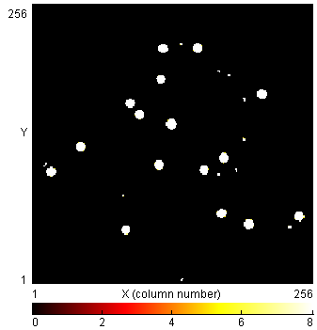
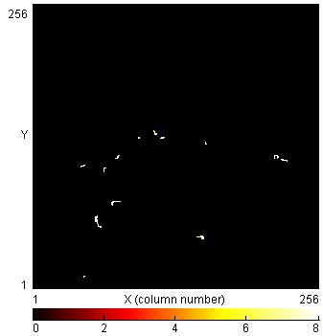
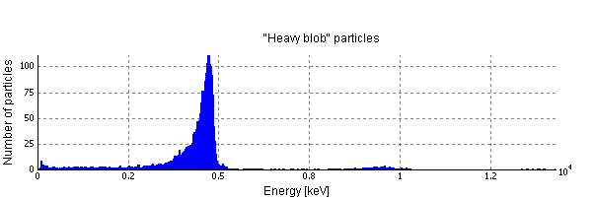
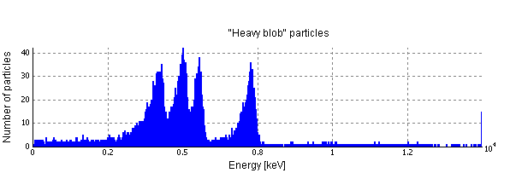
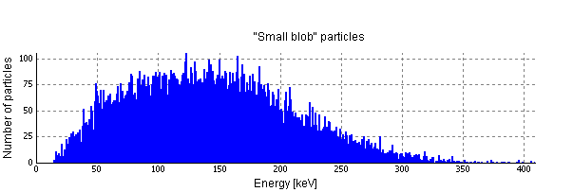
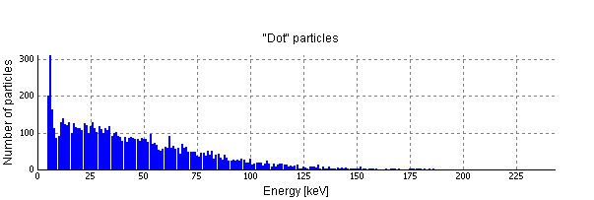
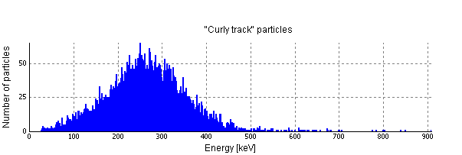
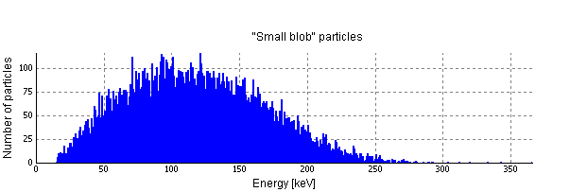
Results
4000 frames: ²³⁹Pu, ²²⁶Ra; 2000 frames: ²²Na, ⁹⁰Sr
exp. time = 0.001 s
²³⁹Pu
47744 detected particles (43440 alpha)
²²⁶Ra
79098 detected particles (45332 alpha)
²²Na
31222 detected particles (25249 beta)
⁶⁰Co
23143 detected particles (15108 beta)

Slide 7
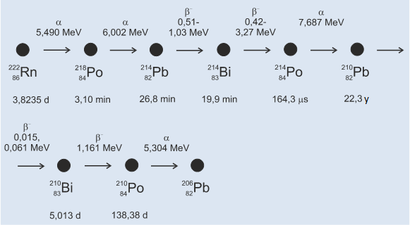
Characterization of sources
RN | A (kBq) | T_{1/2} | E (keV) … a, b | E (keV) … g | X-ray (keV)
²³⁹Pu | 38.720 | 24110 y | a 5157(70.79%), 5144(17.14%), 5106(11.87%) |  | 11-20, 95, 98, 110-111, 114-115
²²⁶Ra | 38.800 | 1600 y | a 4784(94.038%), 4601(5.95%) | 186(3.555%) | 10-17, 81, 84, 94-95
⁶⁰Co | 112.8 | 5.27 y | b⁻ max.317(99.98%) avg.95,6 | 1173 (99.85%), 1332(99.98%) | 7-8
¹³⁷Cs | 102.6 | 30.05 y | b⁻ max.514(94.36%) avg.174, max. 1176(5.64%) avg.416 | 662 (84.99%) | 31-32, 36-37
²²Na | 109.1 | 2.6 y | b⁺ max.546(90.30%) avg.216 | 1275(99.94%), 511 anihilation | Pod 1keV

Slide 8
Shielding x-rays radiation ¹³⁷Cs by aluminium

Slide 9
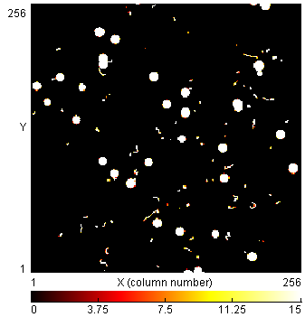
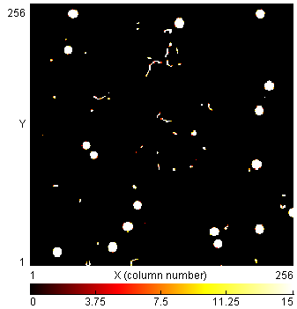
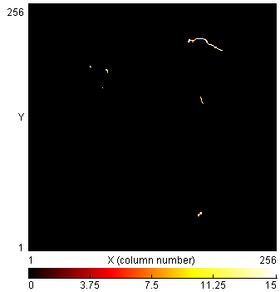
Results – meassurement air sample in room
Time of air sampling = 5 min;
Number of frames = 469;
Time of 1 frame = 30 s;
2. frame: 113 particles
80. frame: 64 particles
150. frame 38 particles
468. frame 6 particles

Slide 10
Thank you for your attention!

